Slide 1





Closing Price Prediction using Sentiment Analysis by LLM & SSA
Netural Language Processing ( NLP )
Date: 27-11-2024

Slide 2





Instructor
Submitted To:
Md.Firoz Hasan
Lecturer (Senior Scale)
Department of
Computer Science and Engineering
BACK
NEXT

Slide 3

Submitted By:
Jannatul Ferdous Riva
ID: 221-15-4928
Batch: 61_A
Department of
Computer Science and Engineering
BACK
NEXT

Slide 4

Outline
01
02
03
04
Introduction
Research Objective
Literature Review
Methodology
05
06
07
Experimental Analysis
Conclusion
Reference
BACK
NEXT

Slide 5



Introduction
Predicting stock prices is challenging because financial markets are highly dynamic and unpredictable. This project improves stock price predictions by combining advanced sentiment analysis using fine-tuned Large Language Models (LLMs) with a Long Short-Term Memory (LSTM) model. It also uses a novel optimization method called the Sparrow Search Algorithm (SSA) to enhance the model’s accuracy. These techniques are applied to predict Tesla’s stock price, demonstrating better results compared to older methods.
BACK
NEXT

Slide 6
Research Objective
Predict Tesla's stock closing price accurately using advanced methods.
Use a fine-tuned Large Language Model (LLM) for better sentiment scoring.
Apply LSTM networks to capture time-based patterns in stock prices.
Optimize the LSTM model using the Sparrow Search Algorithm (SSA) for better performance.
Compare advanced approaches (LLM and SSA) with traditional techniques to highlight improvements.
BACK
NEXT

Slide 7
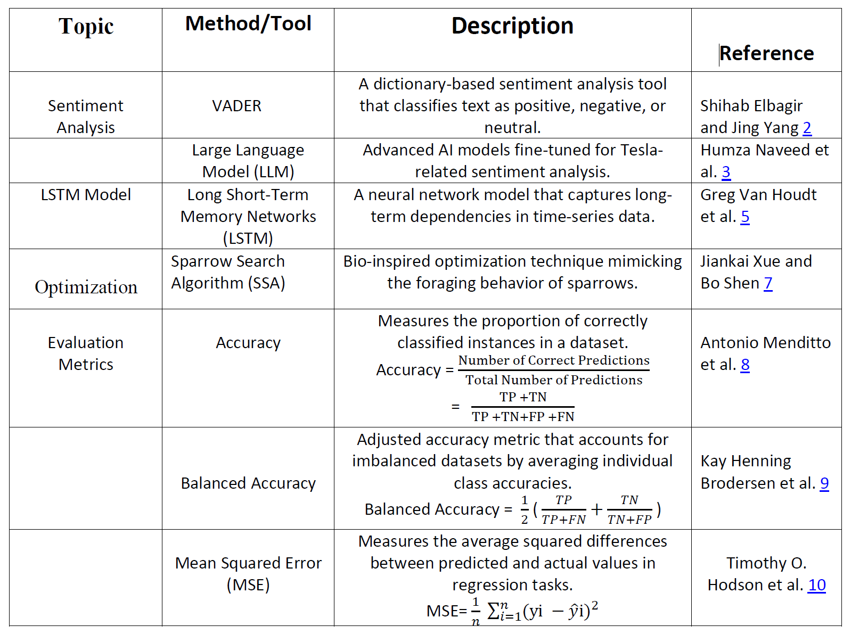
Litrature Review
BACK
NEXT

Slide 8
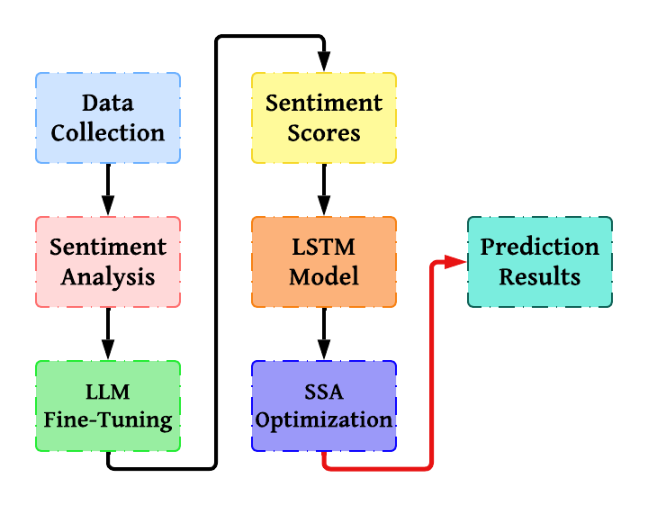
Methodology
BACK
Figure: Methodology Diagram
NEXT

Slide 9
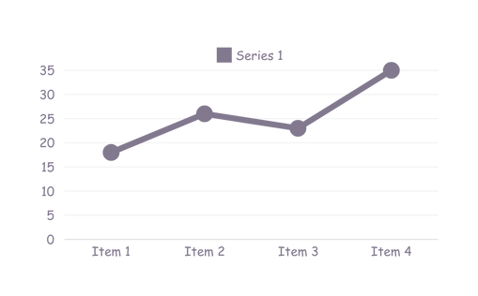
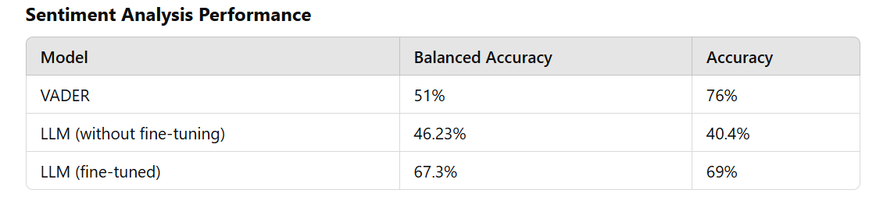
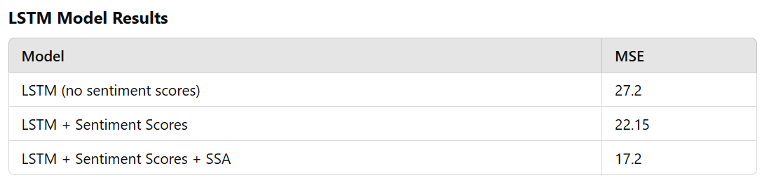
Experimental Analysis
BACK
NEXT

Slide 10
Conclusion
This project demonstrates how combining advanced techniques like sentiment analysis and optimization can significantly improve stock price prediction. By using a fine-tuned Large Language Model (LLM) for sentiment analysis, the model was able to better understand the complex emotions behind tweets about Tesla, leading to more accurate predictions. Additionally, applying the Sparrow Search Algorithm (SSA) to fine-tune the LSTM model’s parameters made the prediction even more precise. These methods together reduced errors and increased prediction accuracy. This approach has great potential to be applied to other financial data and markets for improved accuracy in future stock price predictions.
BACK
NEXT

Slide 11


References
[1] Frank Cao Yun ”Stocktwits 2020 2022 Raw”.
[2] Shihab ”Twitter Elbagir and Jing Yang Sentiment Analysis Using Natural Language Toolkit and 4 VADER Sentiment ”
[3] Humza Naveed, Asad Ullah Khan, Shi Qiu, Muhammad Saqib, Saeed Anwar, Muhammad Usman, Naveed Akhtar, Nick Barnes, Ajmal Mian ”A Comprehen sive Overview of Large Language Mod els”
[4] Tim Dettmers, Artidoro Pagnoni, Ari Holtzman, ”QLoRA: Luke Zettlemoyer Efficient of Quantized LLMs”
[5] Greg Van Houdt, Carlos Mosquera , Gonzalo N´apoles ”A Review on the Long Short-Term Memory Model”
[6] Petro Liashchynskyi, Pavlo Liashchyn skyi ”Grid Search, Random Search, Ge netic Algorithm: A Big Comparison for NAS”
[7] Jiankai Xue and Bo Shen ”A novel swarm intelligence optimization ap proach: sparrow search algorithm”
BACK
NEXT

Slide 12
THANK YOU

